Slide 1

Sprint 2
Learn, create and make it work
Ishant Upadhyay
Rens Visser
11 December 2017

Slide 2
Agenda
Sprint 2 Progress
Sprint 2 burndown Chart
Demo
Impedement
Jira Backlog Refinement

Slide 3
Sprint 2 Progress
Things Done Till Now:
Importing Article from the data source to database.
Importing Customer information from the data source to database.
Investigating the algorithm to Calculate Optimal Route: (Dijkstra's Algorithm)
Calculating the distance and time between two points (Google Distance Matix API)

Slide 4
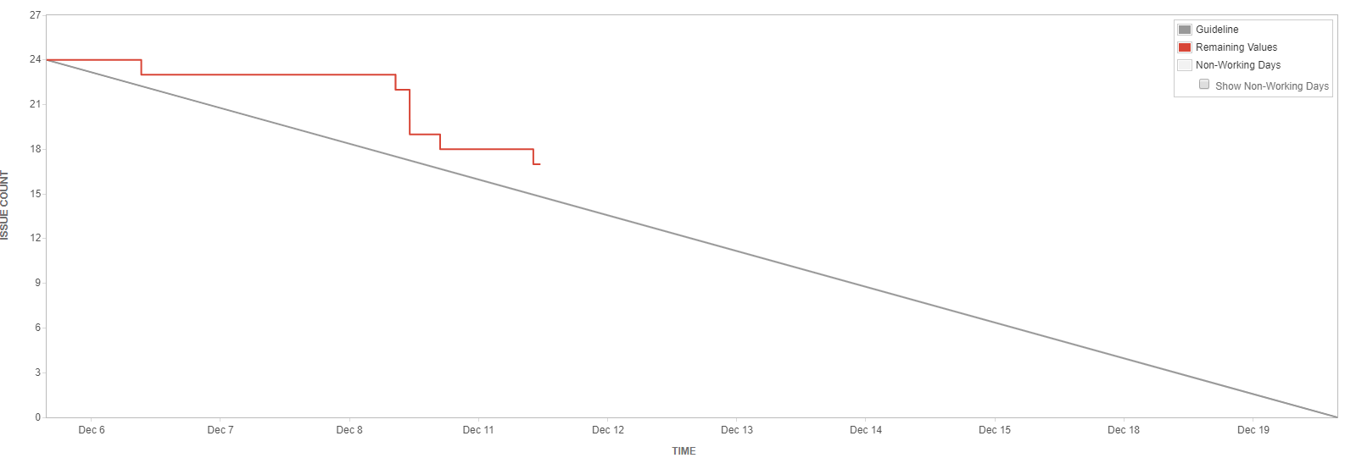
Sprint 2 Burndown Chart

Slide 5
Demo

Slide 6
Impedement
Running the jquery script (Adding Order)

Slide 7
Backlog Refinement

Slide 8
Thank You!

